Slide 1
Billy’s Sports Bar and Grill
Market Analysis
Group 16
Meet Shukla, Samarth Pandya, Brenna Larson, Coan Milton

Slide 2
Case Study
Top 3 best potential investment opportunities for Billy’s Sports Bar and Grill
Texas non-dry counties
Populations 100,000 to 300,000
Geographic, demographic, and income growth analysis

Slide 3
Research Objective
Texas income from Bureau of Economic Analysis
Population data from US Census
Labor force data from Bureau of Labor Statistics
TABC data from Texas Comptroller
Revenue from the sale of alcoholic beverages
Counties’ income per capita, labor force, and population demographics

Slide 4
Recommended Counties
Midland County: FIPS Code 329
Brazos County: FIPS Code 41
Hays County: FIPS Code 209

Slide 5
Methodology
Data Cleaning:
Subset population data for male, female, and total populations for each county, as well as men aged 20-39
Each new variable was then calculated as a percentage of total population
Pulled Labor force and employment/unemployment numbers from BLS data
Filtered tabc data to sum total receipts for mixed drink licenses
Per Capita income for each county

Slide 6
Methodology
Data Cleaning:
Merged all data by county from 2011-2019, then filtered for counties with populations between 100-300k
Calculated employment/unemployment rates
Calculated net sales per capita

Slide 7
Methodology
Regression:
Data was normalized
Using correlation we determined most important indicators for sales per capita
Males 20 to 39 average, Total male average, Per capita net earnings, and employment rate as the important predictor variables and our target market.
Multiple linear regression with y variable as total receipts per capita to determine top 3 counties.

Slide 8
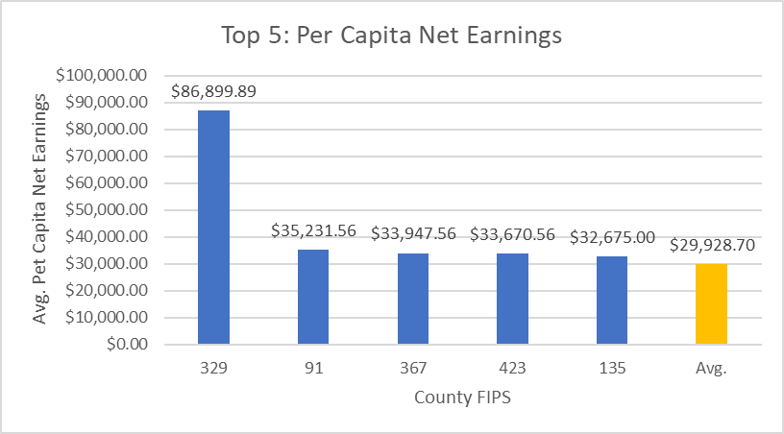
Midland County
Oil and Gas Industry Hotspot
$86,000 Average Earnings Per Net Capita
Increasing Alcohol Sales

Slide 9
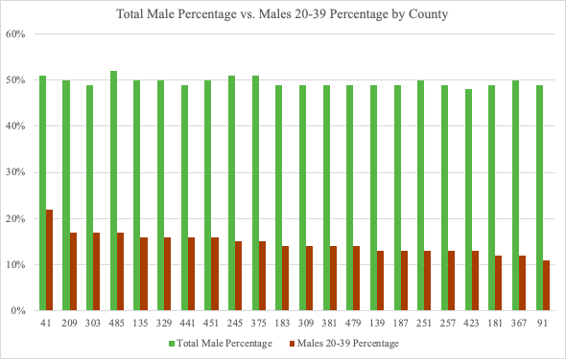
Brazos County
Highest % Population of Males Ages 20-39
4th in Net Earnings
6th in Labor Force
Encompass both Texas A&M University and Blinn College

Slide 10
Hays County
2nd Highest % Population of Males Ages 20-39
Encompasses Texas State University

Slide 11
Questions?
Thank you!

